Slide 1

Computer Networks
Application Layer

Slide 2
Topic of the day
Email Protocol
SMTP
POP3
IMAP
MIME
IP Addressing Protocols
DNS

Slide 3
Email Protocol
Email is a store-and-forward method of sending, storing, and retrieving electronic messages.
Email messages are stored in databases on mail servers.
Email clients communicate with mail servers to send and receive email.
Mail servers communicate with other mail servers to transport messages from one domain to another.
Email clients do not communicate directly when sending email.
Email relies on three separate protocols for operation: SMTP (sending),POP (retrieving), IMAP (retrieving).

Slide 5
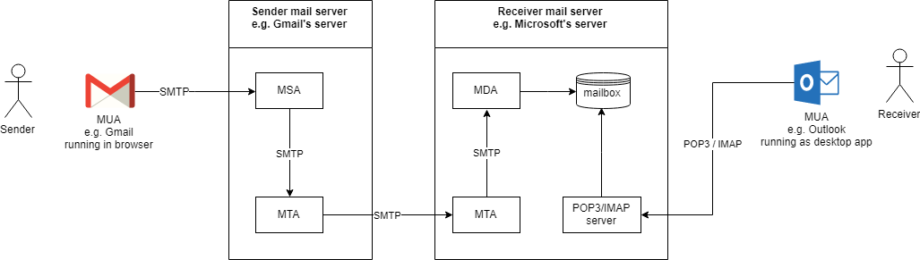

Slide 6
MUA (Mail User Agent) :Client application that allows receiving and sending emails. It can be a desktop application such as Microsoft Outlook/Thunderbird/… or web-based such as Gmail/Hotmail/… (the latter is also called Webmail).
MSA (Mail Submission Agent): A server program that receives mail from an MUA, checks for any errors, and transfers it (with SMTP) to the MTA hosted on the same server.
MTA (Mail Transfer Agent): A server application that receives mail from the MSA, or from another MTA. It will find (through name servers and the DNS) the MX record from the recipient domain's DNS zone in order to know how to transfer the mail. It then transfers the mail (with SMTP) to another MTA (which is known as SMTP relaying) or, if the recipient’s server has been reached, to the MDA.
Examples of MTAs are Postfix, Exim, Sendmail, qmail, ...
MDA (Mail Delivery Agent): A server program that receives mail from the server’s MTA, and stores it into the mailbox. MDA is also known as LDA (Local Delivery Agent).
An example is Dovecot, which is mainly a POP3 and IMAP server allowing an MUA to retrieve mail, but also includes an MDA which takes mail from an MTA and delivers it to the server’s mailbox.
Mailbox: maildir/mbox: The server’s mail storage. Maildir is a way of storing email messages. It is usually preferable over mbox.

Slide 7
SMTP
Protocol used by MUAs to send emails to an MSA.
IMAP/POP3
Protocols used by MUAs to retrieve emails from a server mailbox. POP3 deletes the email messages from the server after they have been downloaded. IMAP is usually preferable as it maintains all email messages on the server, permitting management of a mailbox by multiple email clients.
MX (Mail Exchanger) record
A Mail Exchanger (MX) record in the DNS specifies which server is responsible for accepting email addresses on behalf of a domain. The host name from the MX record must map to one or more address record (A or AAAA) in the DNS, and must not point to any CNAME records.

Slide 8
SMTP Operation
SMTP message formats require a message header and body.
The body can contain any amount of text.
The header must have a properly formatted recipient email address and a sender address.
An SMTP client sends an email by connecting to a SMTP server on port 25, 465(secure).
The server receives the message and stores it message in a local mailbox or relays the message to another mail server.
Users use email clients to retrieve messages stored on the server.
IMAP and POP are two protocols commonly used by email clients to retrieve messages.
Notes:
By default, the SMTP protocol works on three ports:
Port 25 – this is the default SMTP non-encrypted port;
Port 2525 – this port is opened on all SiteGround servers in case port 25 is filtered (by your ISP for example) and you want to send non-encrypted emails with SMTP;
Port 465 – this is the port used if you want to send messages using SMTP securely.

Slide 10
SMTP is application level protocol.
SMTP is connection oriented protocol.
SMTP is text based protocol.
It handles exchange of messages between e-mail servers over TCP/IP network.
Apart from transferring e-mail, SMPT also provides notification regarding incoming mail.
When you send e-mail, your e-mail client sends it to your e-mail server which further contacts the recipient mail server using SMTP client.
These SMTP commands specify the sender’s and receiver’s e-mail address, along with the message to be send.
The exchange of commands between servers is carried out without intervention of any user.
In case, message cannot be delivered, an error report is sent to the sender which makes SMTP a reliable protocol.

Slide 11
HELLO
This command initiates the SMTP conversation.
EHELLO
This is an alternative command to initiate the conversation. ESMTP indicates that the sender server wants to use extended SMTP protocol.
MAIL FROM
This indicates the sender’s address.
RCPT TO
It identifies the recipient of the mail. In order to deliver similar message to multiple users this command can be repeated multiple times.
SIZE
This command let the server know the size of attached message in bytes.
DATA
The DATA command signifies that a stream of data will follow. Here stream of data refers to the body of the message.
QUIT
This commands is used to terminate the SMTP connection.
VERFY
This command is used by the receiving server in order to verify whether the given username is valid or not.
EXPN
It is same as VRFY, except it will list all the users name when it used with a distribution list.

Slide 12
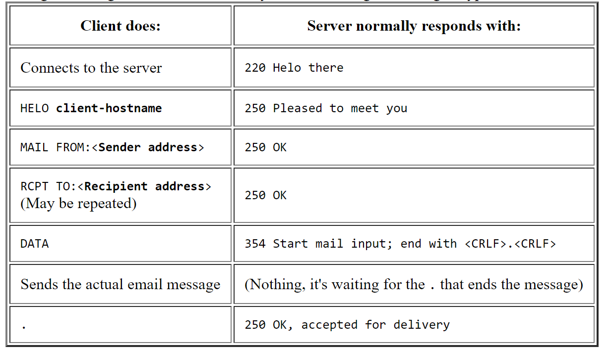
Notes:
Response Codes
220: Service Ready
250: Request Command Completed

Slide 13
POP Operation
Messages are downloaded from the server to the client.
The server listens on port 110, 995(secure) TCP for client requests.
Email clients direct their POP requests to mail servers on port TCP 110.
The POP client and server exchange commands and responses until the connection is closed or aborted.
POP allows for email messages to be downloaded to the client’s device (computer or phone) and removed from the server.
There is no centralized location where email messages are kept.
A downloaded message resides on the device that triggered the download.

Slide 14
POP is an application layer internet standard protocol.
Since POP supports offline access to the messages, thus requires less internet usage time.
POP does not allow search facility.
In order to access the messaged, it is necessary to download them.
It allows only one mailbox to be created on server.
It is not suitable for accessing non mail data.
POP commands are generally abbreviated into codes of three or four letters. Eg. STAT.

Slide 15
S.N. | Command Description
1 | LOGIN This command opens the connection.
2 | STAT It is used to display number of messages currently in the mailbox.
3 | LIST It is used to get the summary of messages where each message summary is shown.
4 | RETR This command helps to select a mailbox to access the messages.
5 | DELE It is used to delete a message.
6 | RSET It is used to reset the session to its initial state.
7 | QUIT It is used to log off the session.

Slide 16
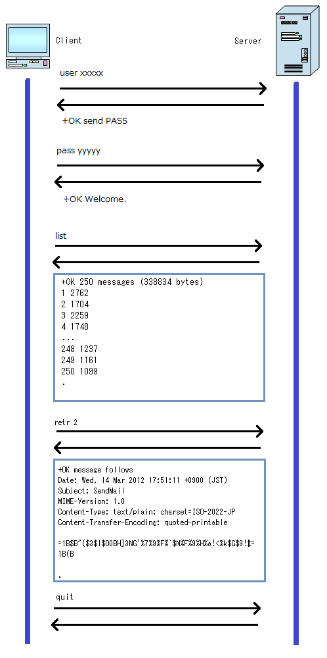
Here is the basic flow to receive mail:
Open connection
Authenticate
List
Retr
Quit

Slide 17
IMAP Operation
IMAP is another protocol used to retrieve email messages.
Allows for messages to be displayed to the user rather than downloaded.
The original messages reside on the server until manually deleted by the user.
Users view copies of the messages in their email client software.
Users can create a folder hierarchy on the server to organize and store mail.
That file structure is displayed on the email client.
When a user decides to delete a message, the server synchronizes that action and deletes the message from the server.
Notes:
Internet Message Access Protocol (IMAP) means that all of your email is saved on your Internet Service Provider's servers. If you are using IMAP, you can run an email program at home and an email program at work and both programs will access the same set up messages and folders.
By default, the IMAP protocol works on two ports: Port 143 – this is the default IMAP non-encrypted port; Port 993 – this is the port you need to use if you want to connect using IMAP securely.

Slide 18
IMAP allows the client program to manipulate the e-mail message on the server without downloading them on the local computer.
The e-mail is hold and maintained by the remote server.
It enables us to take any action such as downloading, delete the mail without reading the mail.It enables us to create, manipulate and delete remote message folders called mail boxes.
IMAP enables the users to search the e-mails.
It allows concurrent access to multiple mailboxes on multiple mail servers.
Notes:
While the POP3 protocol assumes that your email is being accessed only from one application, IMAP allows simultaneous access by multiple clients. This is why IMAP is more suitable for you if you’re going to access your email from different locations or if your messages are managed by multiple users.

Slide 19
Home TASK
Explore MIME
Write a short report on its working.
Identify the issues(security and performance) in it?

Slide 20
IP Addressing Protocols - DNS
Domain Name System
While IP addresses are crucial for network communication, they are not easy to memorize.
Domain names are created to make server addresses more user-friendly.
Domain names such as http://www.cisco.com are user-friendly addresses associated with the IP address of a specific server.
However, computers still need the actual numeric address before they can communicate.

Slide 21
Domain Name System
The DNS protocol allows for the dynamic translation of a domain name into the correct IP address.
The DNS protocol communications using a single format called a message.

Slide 23
DNS Message Format
DNS supports different types of records. Some of these record types are:
o A - An end device IPv4 address
o NS - An authoritative name server
o AAAA - An end device IPv6 address (pronounced quad-A)
o MX - A mail exchange record
DNS servers will first look at its own records to resolve the name. If the server is unable to resolve the name using its locally stored records, it relays the query to other servers.
The response is then forwarded to the requesting client.
The DNS Client service on Windows PCs also stores previously resolved names in memory.
ipconfig /displaydns displays all of the cached DNS entries on Windows.

Slide 25
DNS Hierarchy
The DNS protocol uses a hierarchical system, with the root at the top and branches below. The naming structure is broken down into small, manageable zones.
Each DNS server is only responsible for managing name-to-IP mappings for that small portion of the DNS structure.
Requests for zones not stored in a specific DNS server are forwarded to other servers for translation.
Top-level domains represent either the type of domain or the country of origin.
Examples of top-level domains are:
o .com - a business or industry
o .org - a non-profit organization
o .au - Australia
o .co - Colombia

Slide 26
Notes:
Ipconfig/displaydns

Slide 27
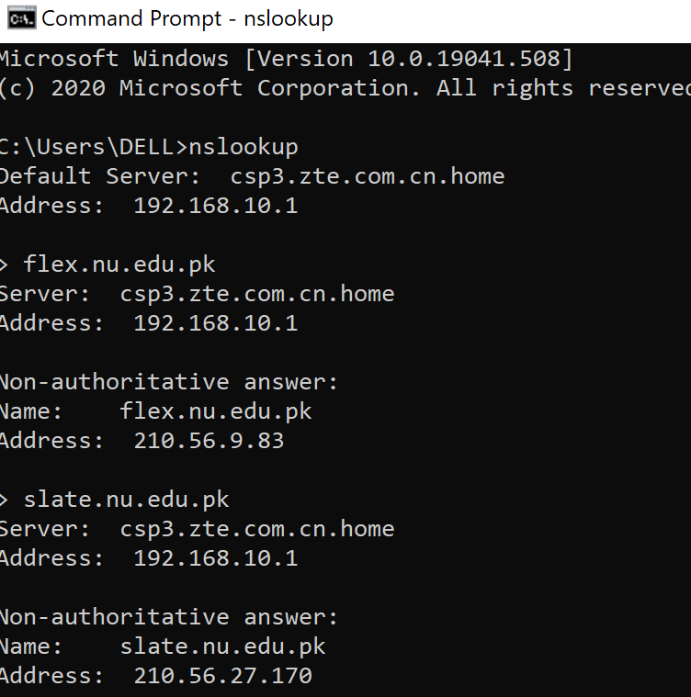
Nslookup Command
Allows the user to manually place DNS queries.
It can also be used to troubleshoot name resolution issues.
Has many options available for extensive testing and verification of the DNS process.
DDNS: Dynamic Domain Name System
DNS Caching

Slide 28
DNS Security Issues
Major attacks:
DNS Hijacking
Cache Poisoning/ DNS Spoofing
DNS DOS attack
DNS SEC

Slide 29
References
https://www.siteground.com/tutorials/email/protocols-pop3-smtp-imap/#:~:text=By%20default%2C%20the%20IMAP%20protocol,to%20connect%20using%20IMAP%20securely.
https://afreshcloud.com/sysadmin/mail-terminology-mta-mua-msa-mda-smtp-dkim-spf-dmarc
https://www.ukessays.com/essays/computer-science/email-protocol-smtp-pop-mime-9752.php
https://www.codeproject.com/Articles/404066/Understanding-the-Insides-of-the-POP3-Mail-Protoco
https://www.tutorialspoint.com/internet_technologies/e_mail_protocols.htm

